Slide 1
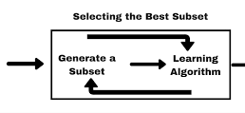
Machine Learning
Feature Selection

Slide 2

Feature Ranking Motivation
There are often many predictor features, input variables, available for us to work with for subsurface prediction
There are good reasons to be selective, throwing in every possible features is not a good idea!
In general, the best prediction model, careful selection of the fewest features that provide the most amount of information is the best practice

Slide 3


Feature Ranking Motivation More Motivation to Work with Fewer Features
More features result in more complicated workflows that require more professional time and have increased opportunity for blunders
Higher dimensional features sets are more difficult to visualize
More complicated models may be more difficult to interrogate, interpret and QC
Inclusion of highly redundant and colinear variables increases model instability and decreases prediction accuracy in testing
More variables generally increase the computational time required to train the model and the model may be less compact and portable
The risk of overfit increases with the more variables, more complexity

Slide 4



What is Feature Ranking?
More motivation to Work with Fewer Variables
Feature ranking is a set of metrics that assign relative importance or value to each feature with respect to information contained for inference and importance in predicting a response feature
There are wide variety of possible methods to to accomplish this
My recommendation is a wide-array approach with multiple metric, while understanding the assumptions and limitations of each metric

Slide 5

The general types of metrics that can be considered for feature ranking
Visual inspection of Data Distributions and Scatter Plots
Statistical Summaries
Model-based
Recursive Feature Elimination

Slide 6
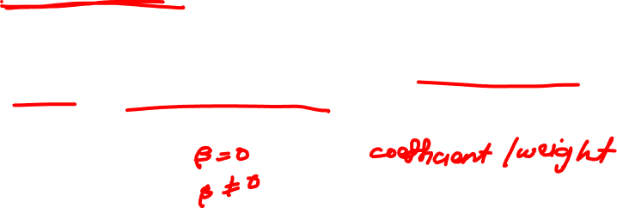
What is feature ranking?
Expert Knowledge
We should not neglect expert knowledge
If additional information is known about physical processes, causation, assigning feature ranks
We should be learning as we perform our analysis, testing new hypothesis

Slide 7

Feature Ranking Metrics
Metric-Visual Inspection
In any multivariate work we should start with the univariate analysis, summary statistics of one variable at a time. The summary statistic ranking method is qualitative, we are asking?
Are there data issues?
Do we trust the features?
Do we trust the features all equally?
Are there issues that need to be taken care of before we develop any multivariate workflows?

Slide 8
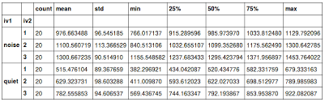

Feature Ranking Metrics
Summary statistics are a critical first step in data checking
The number of valid (non-null) values for each feature
General behaviors such as central tendency, mean and dispersion, variance
Issues with negative values, extreme values, and values that are outside the range of plausible values for each property

Slide 9

Feature Ranking Methods
Ranking Method-Univariate Distributions
AS with summary statistics, this ranking method is a qualitative check for issues with the data and to assess our confidence with each feature
It is better not to include a feature with low confidence of quality as it may be misleading (while adding to model complexity as discussed previously)
Assess our ability to use methods that have distribution assumptions

Slide 10
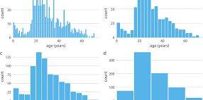
Feature Ranking Metrics
The Univariate distributions look not so good
There are no obvious outliers
The permeability is positively skewed as often observed
The corrected TOC has a small zero truncation spike, but it’s reasonable
Some departure from Normal/Gaussian form could transform

Slide 11
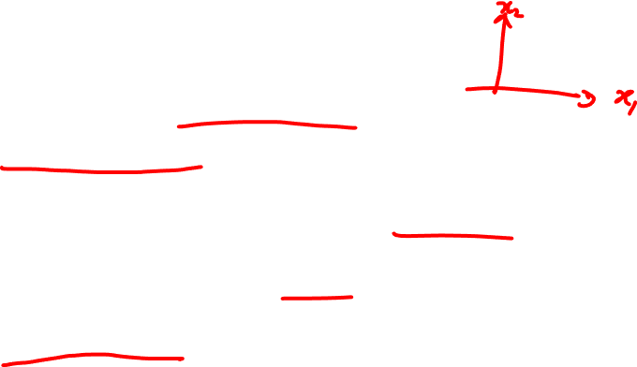
Feature Ranking Metrics
Ranking Method – Bivariate Statistics
Matrix scatter plots are a very efficient method to observe the bivariate relationships between the variables
This is another opportunity through data visualization to identify the data issues, outliers
We can assess if we have collinearity, specifically the simpler form between two features at a time
Bivariate Gaussian is assumed for methods such as correlation and partial correlation

Slide 12
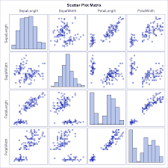

Feature Ranking Metrics
How could we use this plot for variable ranking?
Variables that are closely related to each other
Linear vs non-linear relationships
Constraint relationships and heteroscedasticity between variables

Slide 13
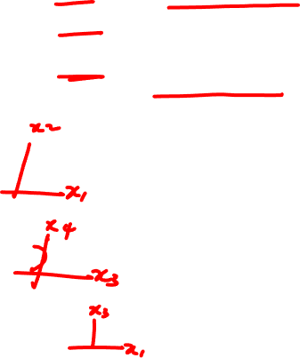
Feature Ranking Metrics
Ranking Method – Bivariate
Bivariate visualization and analysis is not sufficient to understand all the multivariate relationships in the data
Multicollinearity includes strong linear relatiohships between 2 or more features
Higher order nonlinear features, outliers and coverage?
These may be hard to see with only bivariate plots.

Slide 14

Feature Ranking Metrics
Ranking Method – Pairwise Covariance
Pairwise covariance provides a measure of the strength of the linear relationship between each predictor feature and the response feature.
We now specify our goal of this study is to predict production, our response variable, from the other available predictor features
We are thinking predictively now, not inferentially, we want to estimate the function, to accomplish this
Covariance
Measures the strength of the linear relationship between features
Sensitive to the dispersion/variance of both the predictor and response

Slide 15
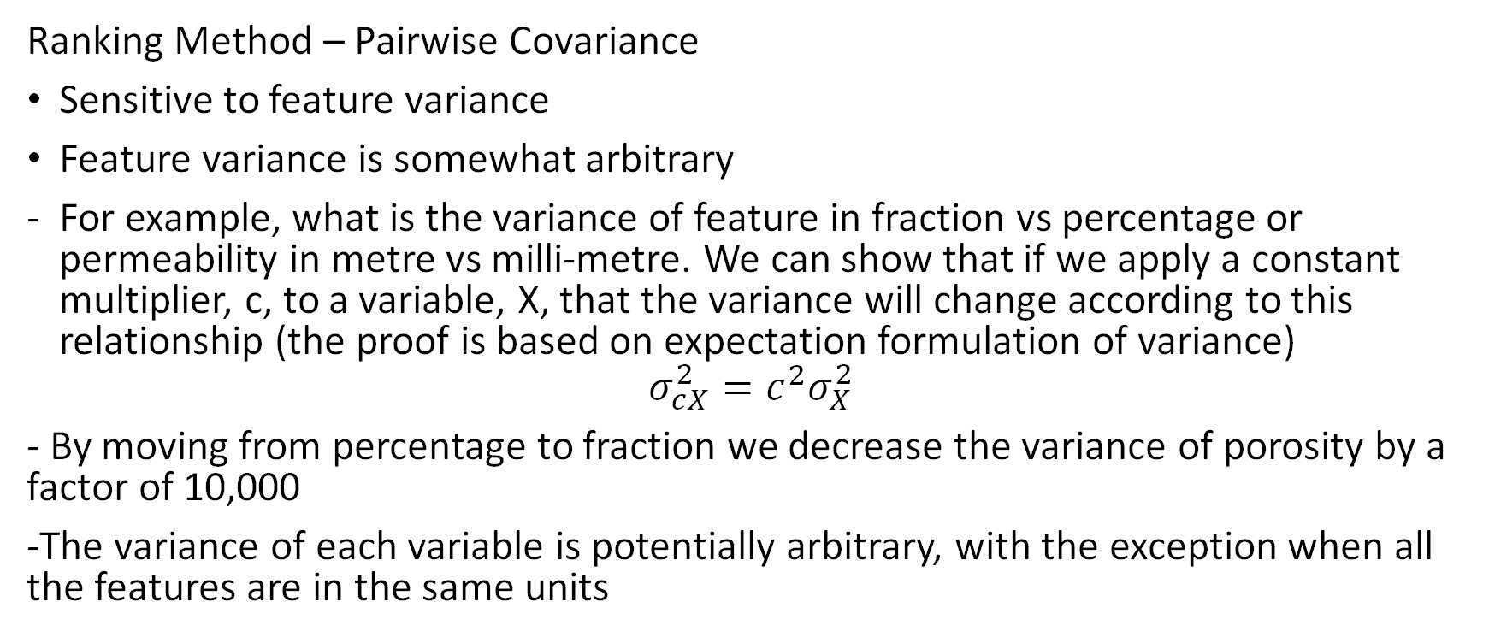
Feature Ranking Metrics
Ranking Method – Pairwise Covariance
Sensitive to feature variance
Feature variance is somewhat arbitrary
For example, what is the variance of feature in fraction vs percentage or permeability in metre vs milli-metre. We can show that if we apply a constant multiplier, c, to a variable, X, that the variance will change according to this relationship (the proof is based on expectation formulation of variance)
$$σ_{cX}^{2}=c^{2}σ_{X}^{2}$$
- By moving from percentage to fraction we decrease the variance of porosity by a factor of 10,000
-The variance of each variable is potentially arbitrary, with the exception when all the features are in the same units

Slide 16

Feature Ranking Metrics
Ranking Method – Pairwise Correlation Coefficient
Pairwise correlation coefficient provides a measure of the strength of the linear relationship between each predictor feature and the response feature
The correlation coefficient
-measures the linear relationship
Removes the sensitivity to the dispersion/variance of both the predictor and response features, by normalizing by the product of the standard deviation of each feature

Slide 17

Feature Ranking Metrics
Ranking Method – Rank Correlation Coefficient
The rank correlation coefficient applies the rank transform to the data prior to calculating the correlation coefficient. To calculate the rank transform simply replace the data values with the ranks, where n is the maximum value and 1 is the minimum value
The rank correlation
-measures the monotonic relationship, relaxes the linear assumption
-removes the sensitivity to the dispersion/variance of both the predictor and response, by normalizing by the product of the standard deviation of each

Slide 18
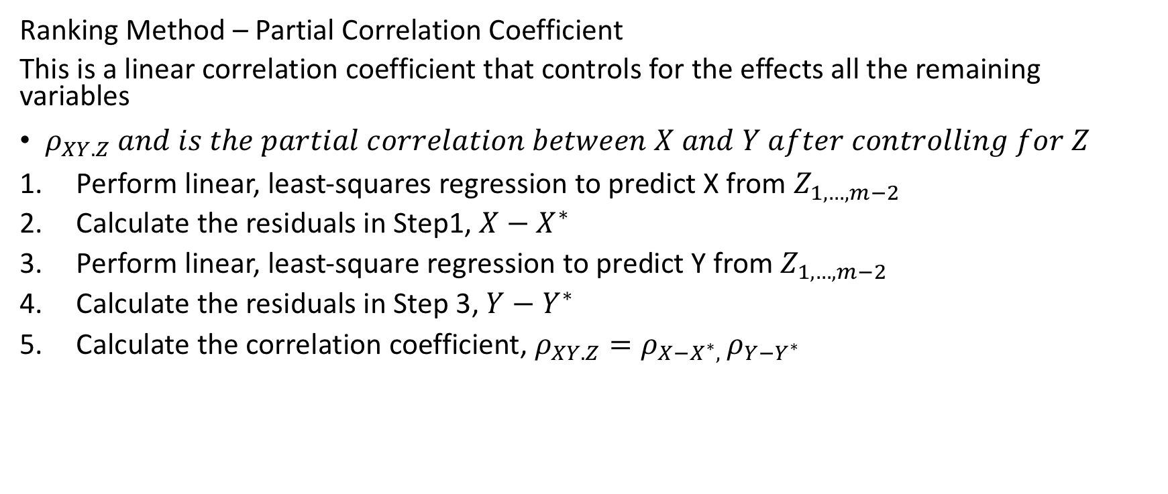

Feature Ranking Metrics
Ranking Method – Partial Correlation Coefficient
This is a linear correlation coefficient that controls for the effects all the remaining variables
$ρ_{XY.Z} and is the partial correlation between X and Y after controlling for Z$
Perform linear, least-squares regression to predict X from $Z_{1,…,m−2}$
Calculate the residuals in Step1, $X−X^{∗}$
Perform linear, least-square regression to predict Y from $Z_{1,…,m−2}$
Calculate the residuals in Step 3, $Y−Y^{∗}$
Calculate the correlation coefficient, $ρ_{XY.Z}=ρ_{X−X^{∗}, }ρ_{Y−Y^{∗}}$

Slide 19
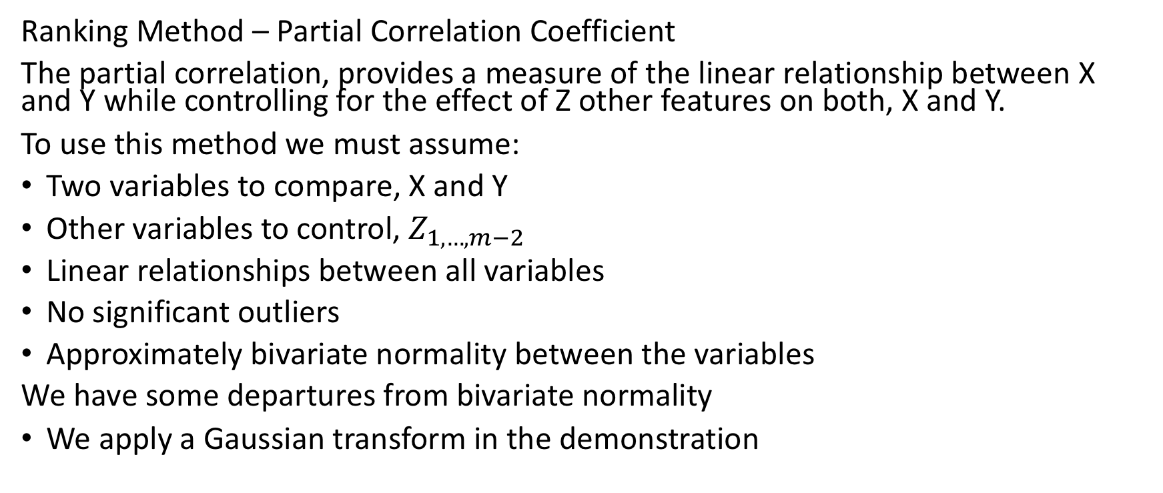
Feature Ranking Metrics
Ranking Method – Partial Correlation Coefficient
The partial correlation, provides a measure of the linear relationship between X and Y while controlling for the effect of Z other features on both, X and Y.
To use this method we must assume:
Two variables to compare, X and Y
Other variables to control, $Z_{1,…,m−2}$
Linear relationships between all variables
No significant outliers
Approximately bivariate normality between the variables
We have some departures from bivariate normality
We apply a Gaussian transform in the demonstration

Slide 20
Feature Ranking Metrics
Ranking Methods – Summary
Are we converging on the features as the most important variables with respect to linear relationship with the production?
What about other features?

Slide 21
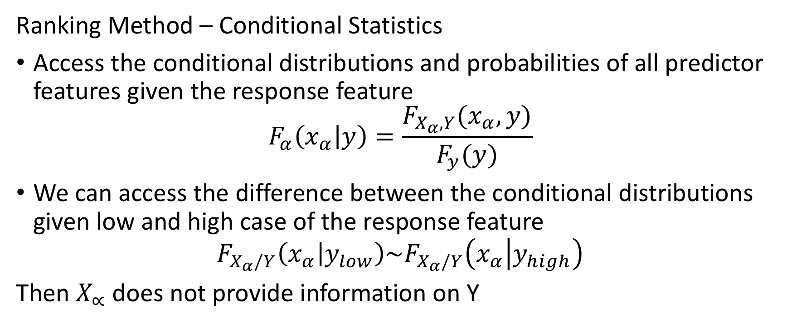
Feature Ranking Metrics
Ranking Method – Conditional Statistics
Access the conditional distributions and probabilities of all predictor features given the response feature
$$F_{α}\left(x_{α} | y\right)=\frac{F_{X_{α},Y}(x_{α},y)}{F_{y}(y)}$$
We can access the difference between the conditional distributions given low and high case of the response feature
$$F_{X_{α}/Y}\left(x_{α} | y_{low}\right)\sim F_{X_{α}/Y}\left(x_{α} | y_{high}\right)$$
Then $X_{∝}$does not provide information on Y

Slide 22
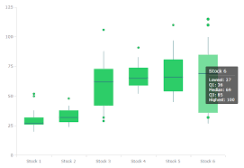

Feature Ranking Metrics
Ranking Method – Conditional Statistics
Standardized each feature, truncate the response feature (if continuous) the build a violin or box plot
Predictor feature

Slide 23
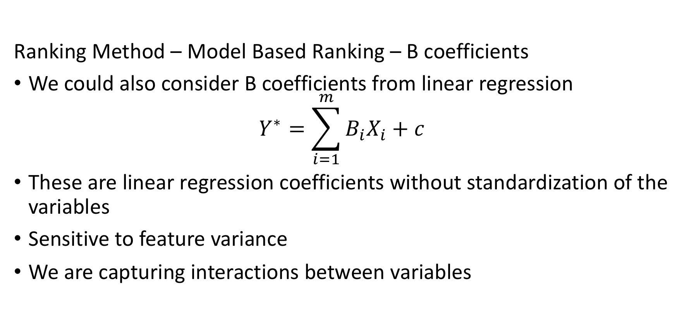

Feature Ranking Metrics
Ranking Method – Model Based Ranking – B coefficients
We could also consider B coefficients from linear regression
$$Y^{∗}=\sum_{i=1}^{m}{B_{i}X_{i}+c}$$
These are linear regression coefficients without standardization of the variables
Sensitive to feature variance
We are capturing interactions between variables

Slide 24
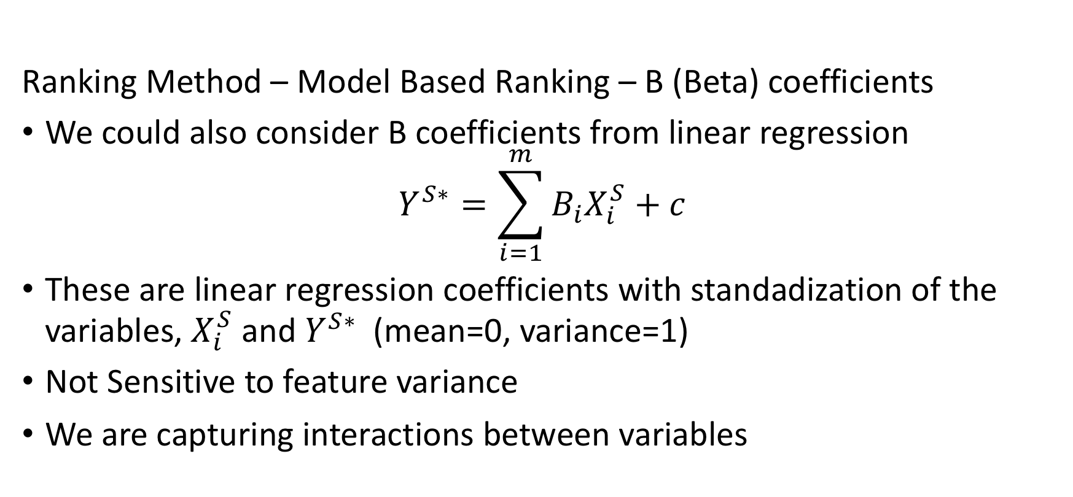

Feature Ranking Metrics
Ranking Method – Model Based Ranking – B (Beta) coefficients
We could also consider B coefficients from linear regression
$$Y^{S∗}=\sum_{i=1}^{m}{B_{i}X_{i}^{S}+c}$$
These are linear regression coefficients with standadization of the variables, $X_{i}^{S}$ and $Y^{S∗}$(mean=0, variance=1)
Not Sensitive to feature variance
We are capturing interactions between variables

Slide 25

Feature Ranking Metrics
Ranking Methods – Recursive Feature Elimination
Recursive Feature Elimination (RFE) Method works by recursively removing features and building a model with the remaining features.
Build a model with all features, calculate coefficient or feature importance (depending on which is available with the modelling method)
Remove the feature with the lowest coefficient or feature importance and rebuild the model
Repeat the process until only one feature remains
Any model could be used
The method assigns rank 1,..,m for all features

